Slide 1
A Matter hotel app
CSIS 4175-070
Alina Pak
Anusha Das
Joao Vitor Wilke Silva
Volodymyr Pavlovskyi
November 2018

Slide 2

Description
Our app is designed for customers who would like to book a room in A Matter hotel in Vancouver. Aside from reserving the room, mobile app helps to view and book outdoor activities, as well as order room service.

Slide 3
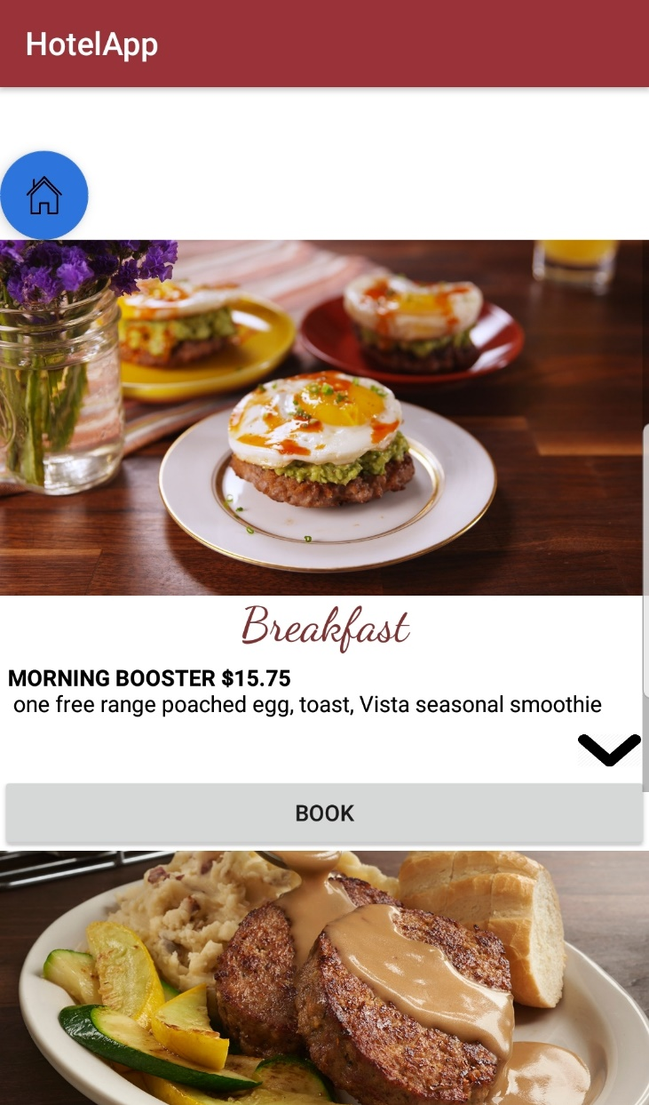
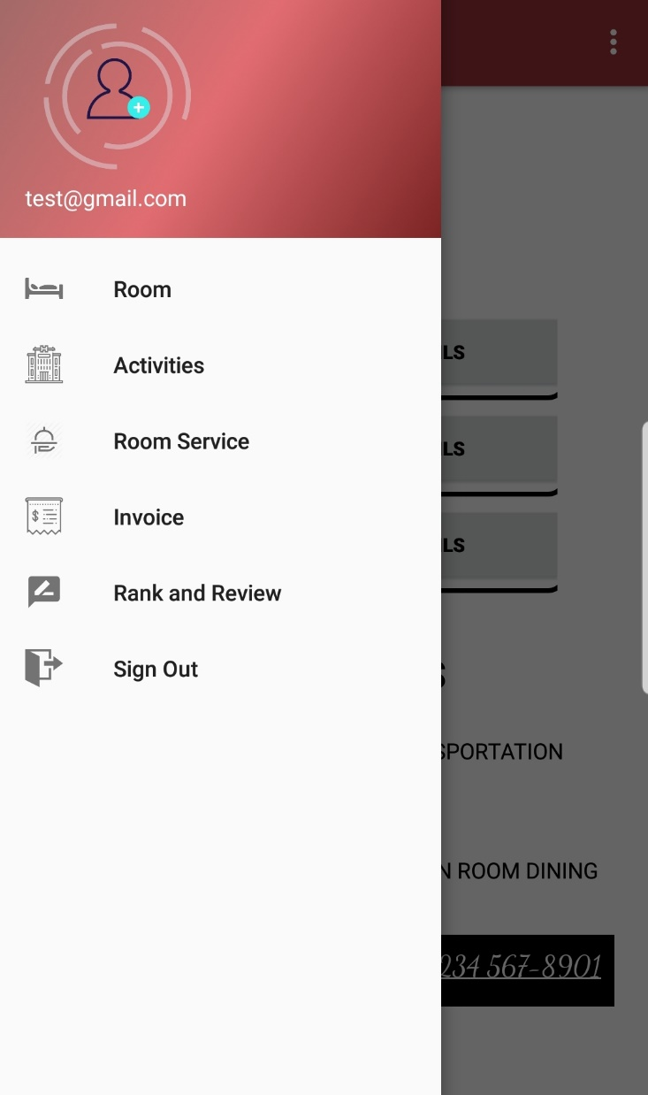
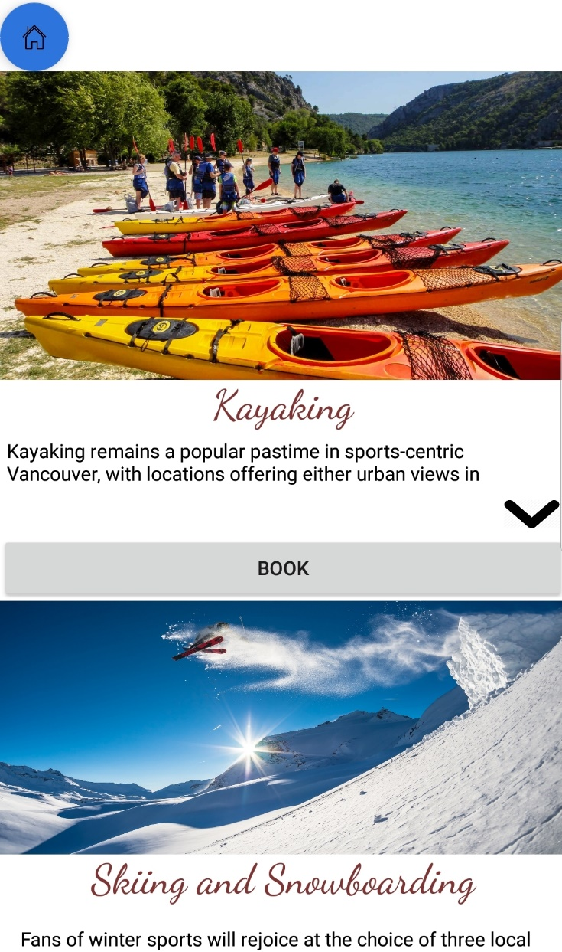
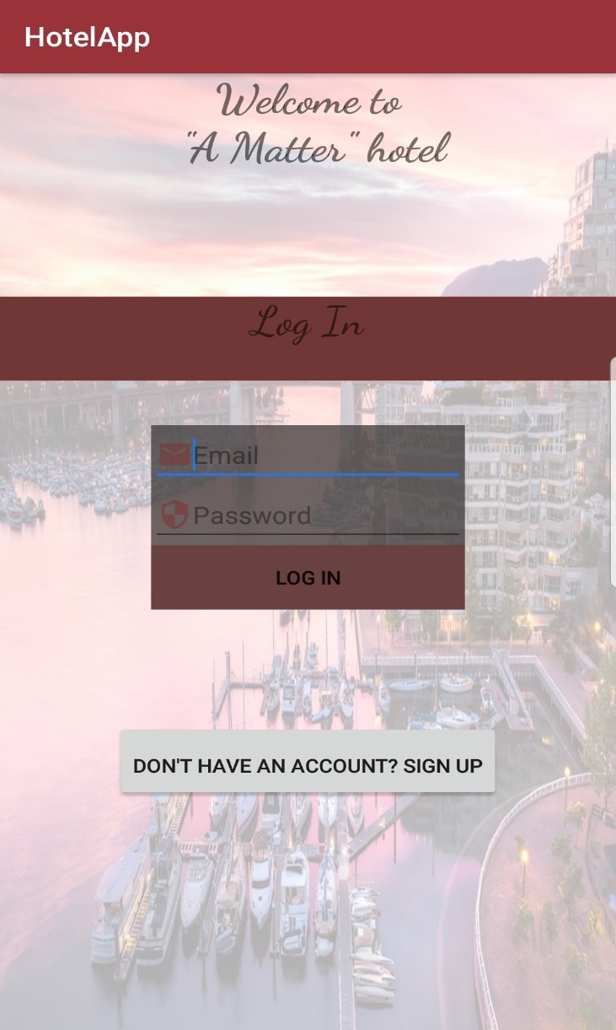
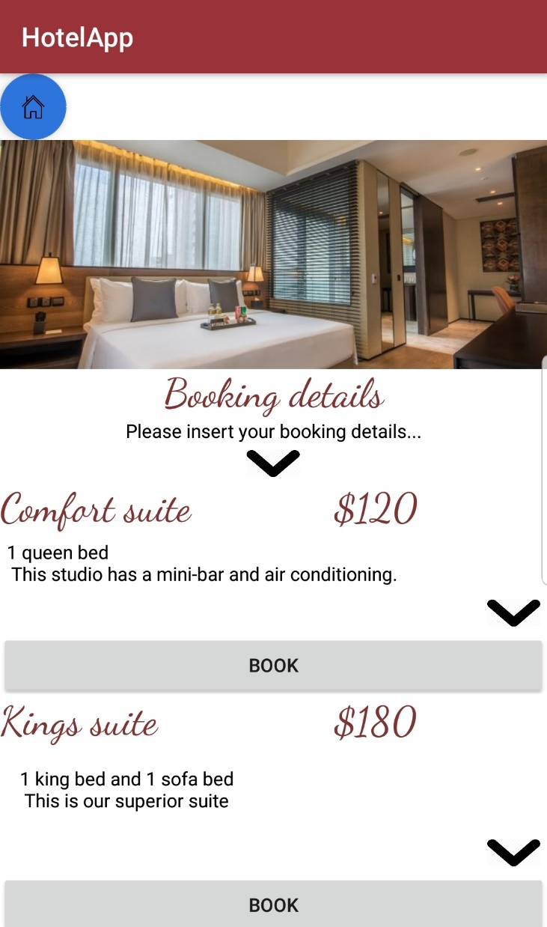
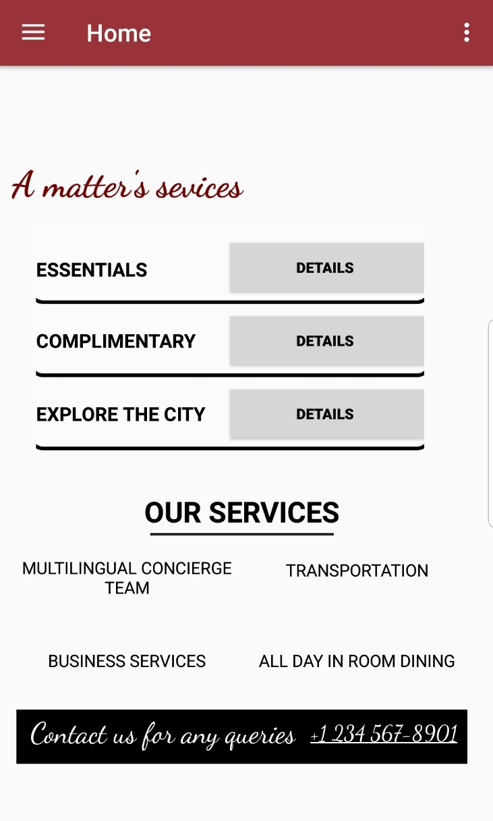
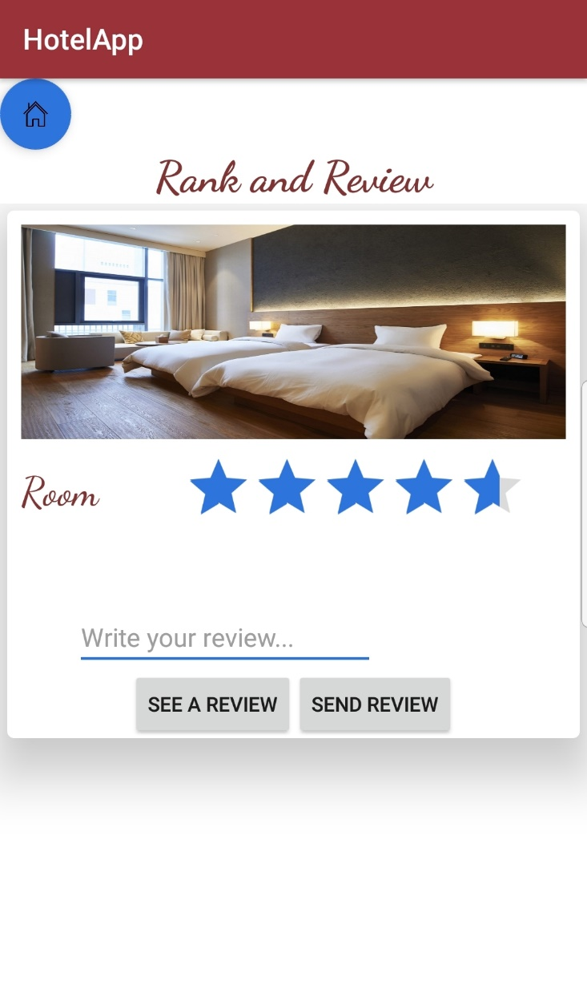

Functionalities
12:38
Sign Up/ Log In
Room Booking
Activities Reservation
Room Service booking
Rank and Review
Invoice
Admin Page

Slide 4
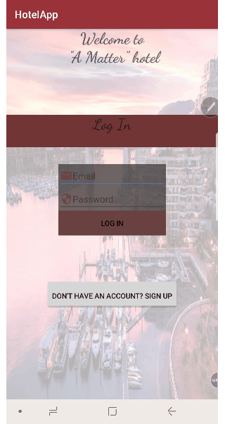
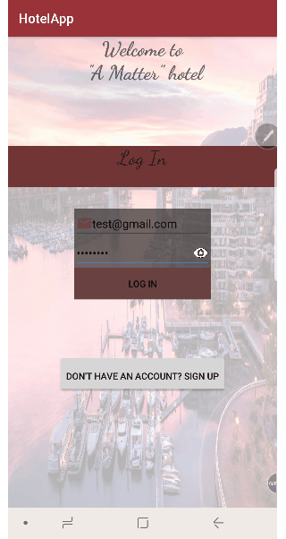
Features
Animation
Custom TextView

Slide 5
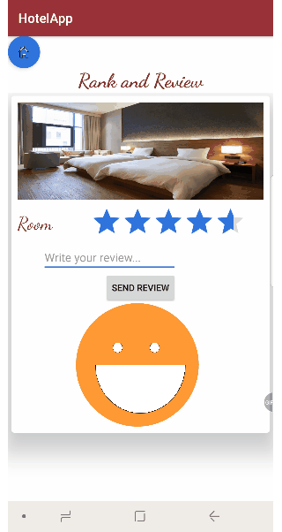
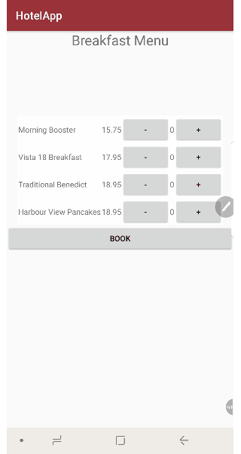

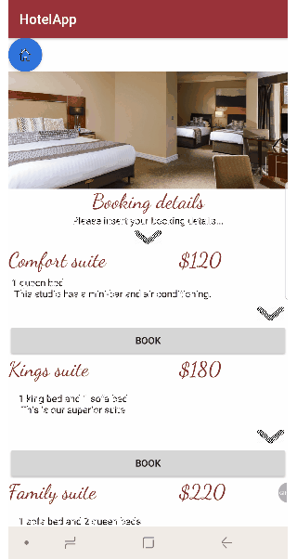
Dynamic Table
ExpandView
RatingBar
Custom View

Slide 6
Features and Challenges
Animation
Fragments
Custom View
Dynamic Fragment
Restriction of Orientation Change
Dynamic Table
Expand View
NavBar (Sidebar)

Slide 7
Features and Challenges cont.
System architecture
Notifications
Firebase Authentication
Threads
Writing to the db (storing users’ booking info)
Rating Bar
Reading from the db (displaying the Invoice)
ListView with adapter
Modifying records (Admin option)

Slide 8
Assumptions, exclusions and rules

Slide 9



Assumptions
Exclusions
Rules
A user:
has an email account
may book more than 1 room for a particular period of days
can book several activities, one a time
must use a new Android (8.0 or higher) smartphone
one person is booking for a group/family
No:
The hotel manager does not have full control over the db
offline support
independent profile management
After additional bookings, a user should always re-check the Invoice to make sure he has an up-to-date info
Admin Page is only visible to System Administrators of the Hotel, which must be added by the database admin and team of developers.

Slide 10

Admin Page
The hidden option

Slide 11
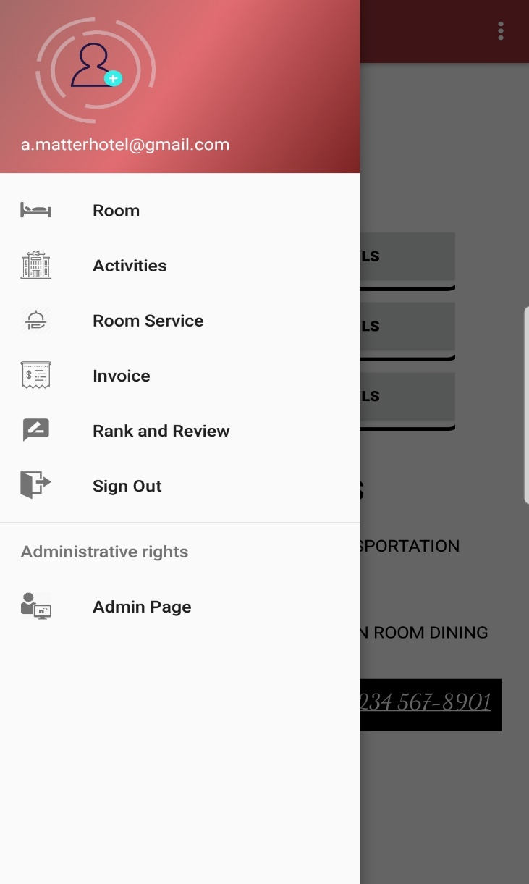
12:38
Admin Page is only visible to Administrators, who have access to a.matterhotel@gmail.com profile.
Features of Admin Page:
Showing all users’ information
Modifying records under a specific user
Deleting a user

Slide 12
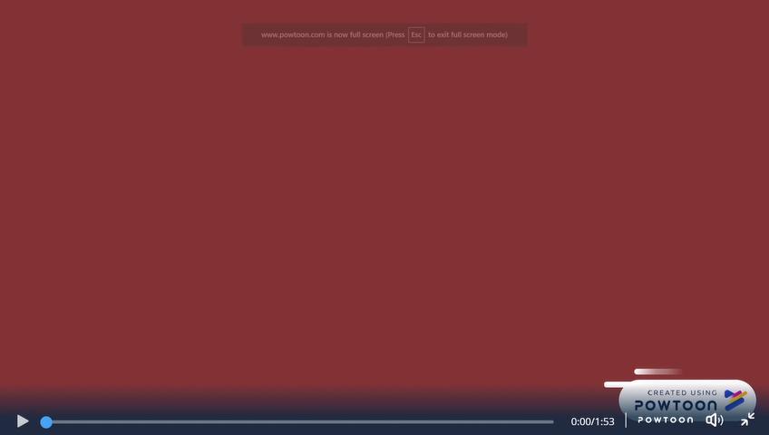
How does it all look like?
User manual…

